Slide 1
Granger Causality Test
Liang Kuang
2017-04-04

Slide 2
Contents
What is Granger Causality Test
Principle and theory
Advantages and limitations
How to use it (example)
Conclusions

Slide 3
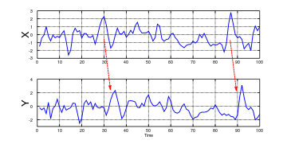
What is Granger Causality Test
When time series X Granger-causes time series Y, the patterns in X are approximately repeated in Y after some time lag (two examples are indicated with arrows). Thus, past values of X can be used for the prediction of future values of Y.

Slide 4
What is Granger Causality Test
Definition
Causality (also referred to as causation,^{[1]} or cause and effect) is the agency or efficacy that connects one process (the cause) with another process or state (the effect), where the first is understood to be partly responsible for the second, and the second is dependent on the first. In general, a process has many causes, which are said to be causal factors for it, and all lie in its past. An effect can in turn be a cause of many other effects.
The Granger causality test is a statistical hypothesis test for determining whether one time series is useful in forecasting another. A time series X is said to Granger-cause Y if it can be shown that those X values provide statistically significant information about future values of Y through a series of t-tests and F-tests on lagged values of X.

Slide 5
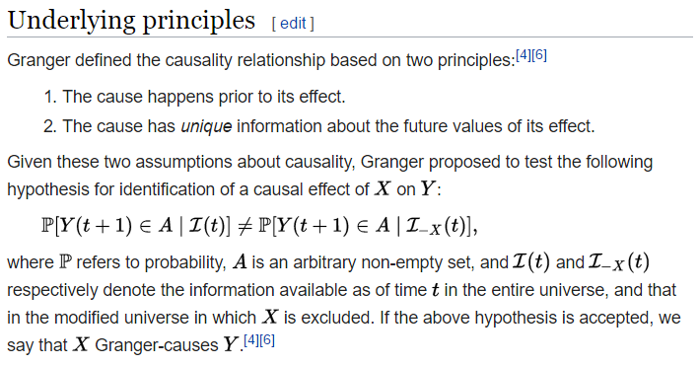
Principle and theory
Assumptions

Slide 6
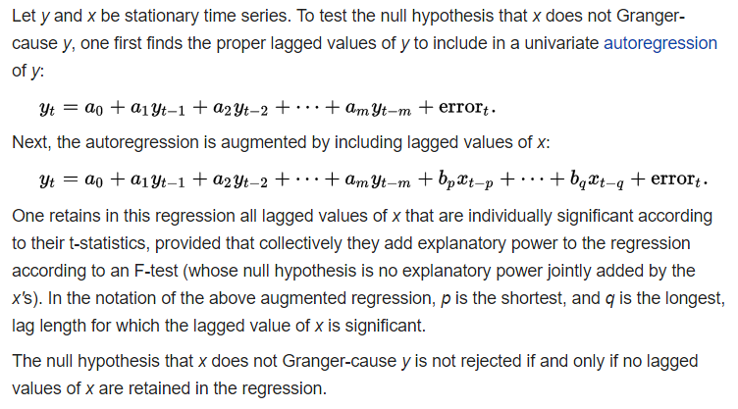
Principle and theory
Mathematical statement and Null Hypothesis

Slide 7
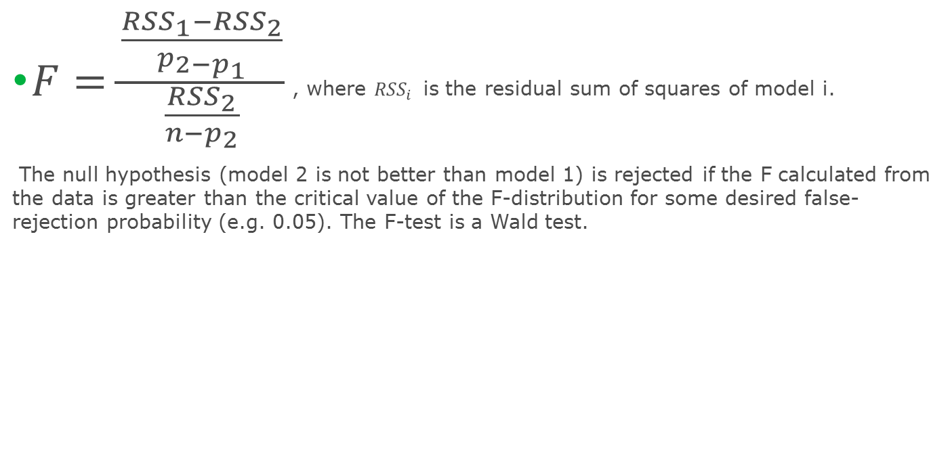
F-statistic
$F=\frac{\frac{{RSS}_{1}−{RSS}_{2}}{p_{2−p_{1}}}}{\frac{{RSS}_{2}}{n−p_{2}}}$ , where ${RSS}_{i }$ is the residual sum of squares of model i.
The null hypothesis (model 2 is not better than model 1) is rejected if the F calculated from the data is greater than the critical value of the F-distribution for some desired false-rejection probability (e.g. 0.05). The F-test is a Wald test.

Slide 8
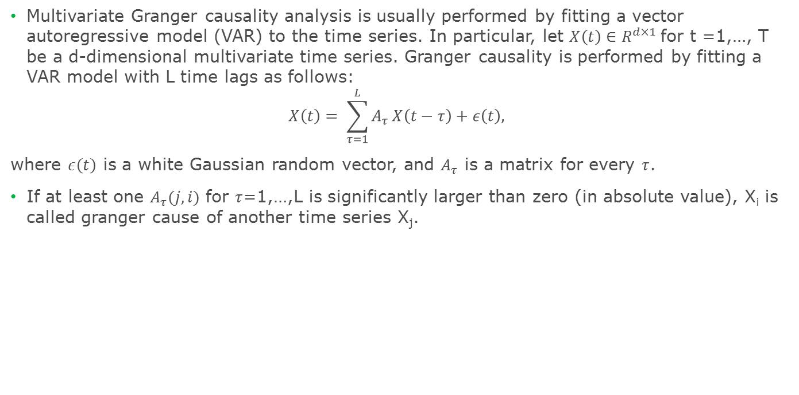
Principle and theory
Multivariate analysis
Multivariate Granger causality analysis is usually performed by fitting a vector autoregressive model (VAR) to the time series. In particular, let $X\left(t\right)∈R^{d×1}$for t =1,…, T be a d-dimensional multivariate time series. Granger causality is performed by fitting a VAR model with L time lags as follows:
$$X\left(t\right)= \sum_{τ=1}^{L}{A_{τ}}X\left(t−τ\right)+ε\left(t\right),$$
where $ε\left(t\right)$ is a white Gaussian random vector, and $A_{τ}$ is a matrix for every $τ$.
If at least one $A_{τ}(j,i)$ for $τ$=1,…,L is significantly larger than zero (in absolute value), X_{i} is called granger cause of another time series X_{j}.

Slide 9
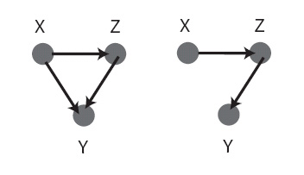
Advantages and limitations
Pros and cons
1. Advantages
Computationally efficient
Still a popular method
2. Limitations
Granger causality is not necessarily true causality but only Humean definition of causality.
Designed to handle pairs of variables and may produce misleading results when true relationship involves three or more variables
Can’t handle non-linear causal relationship
Multivariate test (sometimes referred as ‘conditional G-causality test) can be done with vector autoregression.
Figure 2: Two possible connectivity's that cannot be distinguished by pairwise analysis. Adapted from Ding et al. (2006).

Slide 10
Advantages and limitations
limitations
Application of the above formulation of G-causality makes two important assumptions about the data:
(i) that it is covariance stationary (i.e., the mean and variance of each time series do not change over time),
(ii) that it can be adequately described by a linear model.

Slide 11
How to use it?
Standard approach
1. Standard F-test for pair-wise GNC
Check stationarity for the data
Select the best lag (p)
Convert data into stationary (both X and Y)
Test GNC using ‘grangertest’@lmtest
2. Multivariate GNC test (Toda-Yamamoto)
Test for integration and find the maximum order of integration
Set up a VAR model in the levels (no difference needed)
Determine the lag length for VAR(p)
Test residual serial correlation
Add maximum order of integration to the number of lags VAR(p+m)
Do Wald test for the first p variables only with p degree of freedom using ‘vargranger’@vars

Slide 12
Example/Demo

Slide 13
Humean definition of causality
1. Reductionist approach (All Cs are Es’ or, whenever C, then E.)
2. Three requirements:
Universal association between X and Y
Time precedence of Y by X
Spatiotemporal connection between X and Y

Slide 14
Conclusions
Findings
Granger causality test is useful for pair-wise causality test for stationary time series
Granger causality test should be limited to linear relationship
Conditional causality test (multivariate test) is a better alternative for more than two variables but recommended maximum of five.
Probably not a recommended approach for filtering high-dimensional features dataset, especially when n << d.
It can be recommended as an alternative after-model-selection check to understand whether the leading variable make sense.
Alternative test for large number of variables and lags.

Slide 15
Appendix
Saved slides

Slide 16
Humean definition of causality
1. Reductionist approach (All Cs are Es’ or, whenever C, then E.)
2. Three requirements:
Universal association between X and Y
Time precedence of Y by X
Spatiotemporal connection between X and Y

